Slide 1


Slide 2
The PowerPoint presentation has been developed to assist you present your AWEI results back to your executive, diversity team and network.
The PowerPoint deck may be edited to remove the slides that are not relevant to your submission.
To present this back to your teams:
Remove any benchmarking slides and title pages that may not be relevant to you
Using your scorecard results, add speakers notes and your scores for each section as a reference during presentations

Slide 3
What is the AWEI?
Internationally recognised, gold standard, national benchmarking instrument for LGBTQ workplace inclusion in Australia
Evidence based instrument that assesses each submission against a comprehensive rubric enabling the determination of current and leading practice annually
Tool by which Diversity and HR professionals can measure progress on internal initiatives validated by external, independent and confidential assessment
Tool by which Diversity and HR professionals can benchmark work against industry, sector and other employers within the same tier
Holistic approach to LGBTQ when utilising optional AWEI employee survey
Valuable input into strategy and planning
Developed and assessed by Australia’s not-for-profit employer support program for LGBTQ inclusion

Slide 4

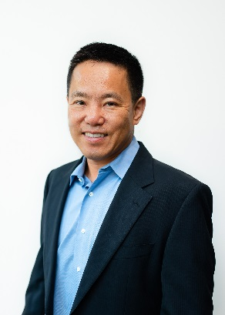
Academically assessed & validated
”It has been my honour to assist with the validation of the scoring methodology used for the Australian Workplace Equality Index. As an academic researcher, I am impressed by the depth, breadth and vigor of this index. The questionnaire not only adopted quantitative measures to ensure objectivity, it also incorporated quality responses to verify and enhance its objectivity. In addition, the markers have taken rigorous steps to ensure that the result is fair, equitable, transparent and objective”
Dr. Raymond Trau
Business/Management - RMIT
Academic Advisor – Index Methodology
Benchmarking Data
All Employers &
by number of employees
“I was fortunate enough to work with a highly dedicated group of people on this important project. As an academic researcher, I was tasked with applying rigorous quantitative analysis to test whether employee cognitive and behavioural factors, and their immediate work environment have a significant impact on their extent of contribution to organisations. With the broad range of organisations participating, I was able to analyse the data with a high level of confidence in our findings.”
Dr. Ilro Lee
Post Doctoral Research Fellow – AGSM, UNSW Business School
Academic Advisor – Survey Findings

Slide 5


Slide 6
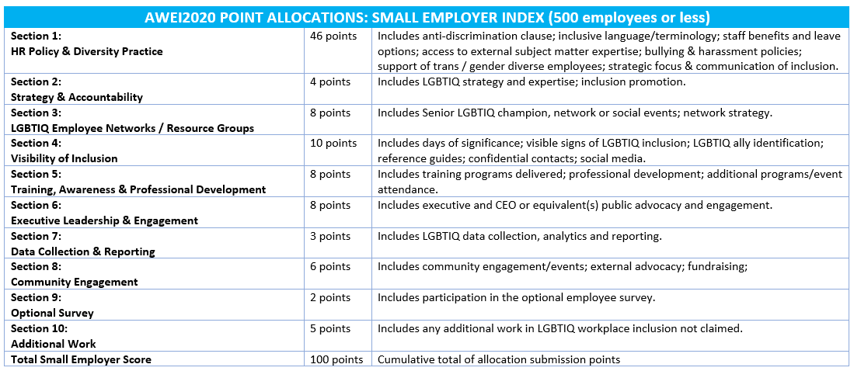


Slide 7
Annual Small Employer AWEI Participation Growth
Note: 2020 Small Employers include up to 500 employers

Slide 8

Small Employer Benchmark: All
TOP 3: (alphabetical)
ADSSI Limited
Dentons
McCullough Robertson Lawyers

Slide 9
Small Employer Benchmark: Global
TOP 3: (alphabetical)
Boston Consulting Group
Oliver Wyman
Page Group

Slide 10

Small Employer Benchmark: Private Sector
TOP 3: (alphabetical):
Dentons
McCollough Robertson Lawyers
Page Group

Slide 11
Small Employer Benchmark: Banking & Finance
TOP 2: (alphabetical)
Deutsche Bank
Royal Bank of Canada

Slide 12
Small Employer Benchmark: NFP/Charity
TOP 2: (alphabetical)
ADSSI Limited
Key Assets – The Children’s Service Provider

Slide 13
Small Employer Benchmark: Legal
TOP 3: (alphabetical)
Clifford Chance
Dentons
McCullough Robertson Lawyers

Slide 14
Small Employer Benchmark: Professional Services
TOP 2: (alphabetical)
Oliver Wyman
Page Group

Slide 15
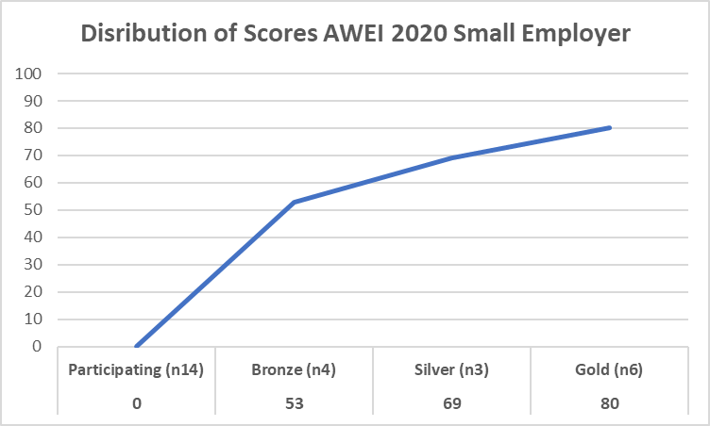
2020 Small Employer Score Distribution: Recognition Tiers
Notes:
These next couple of slides contain general benchmarking data applicable to all submitting organisations and provide some context to the history and ongoing shift in practice.
The chart shows this year’s score distribution across all submissions. Those organisations just starting their LGBTQ inclusion initiatives are encouraged to participate even though their score may be extremely low. This provides an initial benchmark by which they can assess progress over the next year.
Entry point to the bronze, silver and gold tiers are indicated by the vertical lines on the chart. The number of employers within each tier is indicated within brackets.
The table shows the historical entry point score to each of the tiers over the six years of the index and how the entry point to each of the tiers has shifted. Bronze entry point has steadied over the last three years, whereas Silver and Gold Tier entry points continue to climb.

Slide 16
Small Employer Benchmark: Participating Tier
TOP 3: (alphabetical)
Aussie Broadband
Envato
HP Australia

Slide 17
Small Employer Benchmark: Bronze Tier
TOP 3: (alphabetical)
The GPT Group
Key Assets – The Children’s Service Provider
Pinsent Masons

Slide 18
Small Employer Benchmark: Gold Tier
TOP 3: (alphabetical)
Dentons
McCullough Robertson Lawyers
Page Group

Slide 19
STANDARD
EMPLOYERS

Slide 20
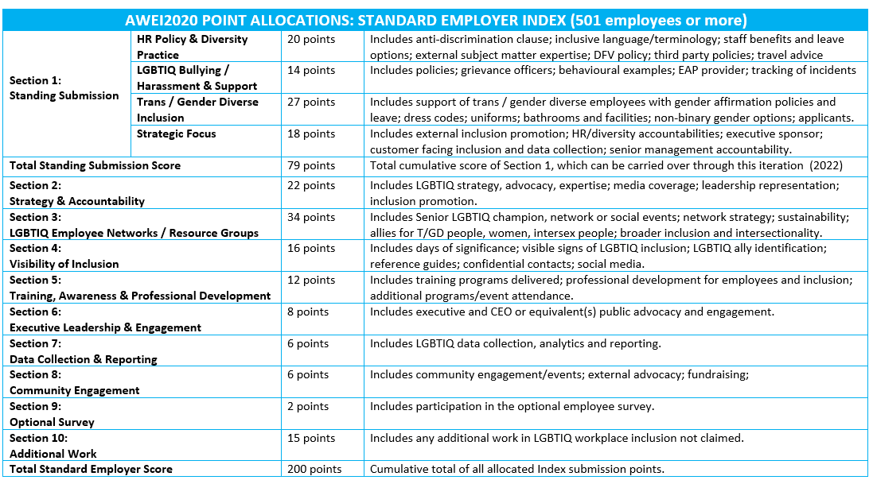

Slide 21
Annual AWEI Submissions: Participation Growth
* Includes Small Employers & Platinum Partner Projects

Slide 22
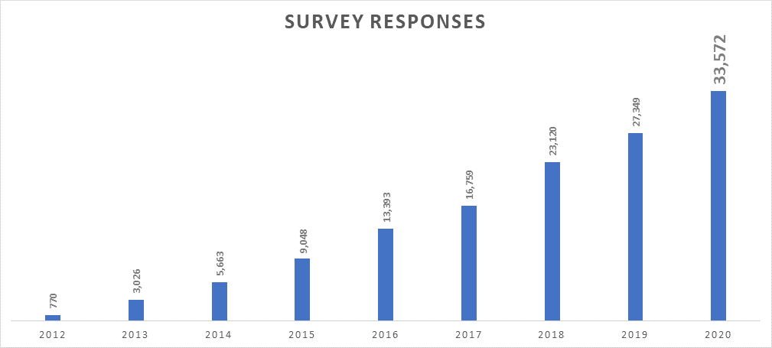
Annual Employee Survey: Participation Growth
*Includes all employers, regardless of Employer Size

Slide 23
Employer Benchmarks

Slide 24
Benchmark: All Employers
TOP 5: (alphabetical)
Capgemini
Clayton Utz
IBM
QBE Insurance
RMIT University
Note: *Two organisations achieved the same score.*

Slide 25
Benchmark: Global Employers
TOP 3: (alphabetical)
Capgemini
IBM
RMIT University

Slide 26
Benchmark: Regional Head Office Employers
TOP 3: (alphabetical)
Deakin University
NBN co
University of Wollongong

Slide 27
Benchmark: 501-1999 Employees
TOP 3: (alphabetical)
Capgemini
Clayton Utz
JP Morgan

Slide 28
Benchmark: 2000-8000 Employees
TOP 3: (alphabetical)
IBM
QBE Insurance
University of New South Wales

Slide 29
Benchmark: 8000+ Employees
TOP 3: (alphabetical)
NAB
PwC
RMIT University

Slide 30
Sector Benchmarks

Slide 31
Public Sector
TOP 3: (alphabetical)
Brisbane City Council
Dept. of Agriculture
Queensland Dept of Education

Slide 32
Private Sector
TOP 3: (alphabetical)
Capgemini
Clayton Utz
IBM
QBE Insurance
*Two organisations achieved the same score.*

Slide 33
Federal Government
TOP 3: (alphabetical)
CSIRO
Dept. of Agriculture
SBS

Slide 34
State & Local Government
TOP 3: (alphabetical)
Brisbane City Council
NSW Police Force
Queensland Dept. of Education

Slide 35
State Government
TOP 3: (alphabetical)
Dept. of Education and Training
Dept of Health & Human Services
NSW Police Force
Queensland Dept. of Education
*Two organisations achieved the same score.*

Slide 36
Higher Education
TOP 3: (alphabetical)
Deakin University
RMIT University
University of New South Wales

Slide 37
Not-for-Profit / Charities
TOP 2: (alphabetical)
Settlement Services International
Uniting

Slide 38
Industry Benchmarking

Slide 39
ASX Top 50
TOP 3: (alphabetical)
NAB
QBE Insurance
Woolworths

Slide 40
Banking & Finance
TOP 3: (alphabetical)
JP Morgan
NAB
QBE Insurance

Slide 41
Community Services
TOP 3: (alphabetical)
Brisbane City Council
Settlement Services International
Victorian Dept. of Environment, Land, Water and Planning

Slide 42
Energy/Utilities
TOP 3: (alphabetical)
AGL Energy
Energy Australia
Victorian Department of Environment, Land, Water and Planning

Slide 43
Health & Wellbeing
TOP 3: (alphabetical)
Department of Health
Life without Barriers
Uniting

Slide 44
Hospitality
TOP 3: (alphabetical)
Coles
The Star Entertainment Group
Woolworths

Slide 45
Insurance
TOP 3: (alphabetical)
Hollard Insurance
Qantas
QBE Insurance

Slide 46
Legal
TOP 3: (alphabetical)
Clayton Utz
KPMG Australia
MinterEllison

Slide 47
Professional Services
TOP 3: (alphabetical)
Capgemini
Clayton Utz
PwC

Slide 48
Property & Construction
TOP 3: (alphabetical)
Brisbane City Council
CBRE
Qantas

Slide 49
Property / Real Estate
TOP 3: (alphabetical)
Brisbane City Council
CBRE
ScentreGroup

Slide 50
Resources / Mining
TOP 3: (alphabetical)
Alcoa of Australia
Dept. of Natural Resources, Mines and Energy
Newmont

Slide 51
Retail
TOP 3: (alphabetical)
ScentreGroup
Stockland
Woolworths

Slide 52
Technology / Communications
TOP 3: (alphabetical)
IBM
NBN co
Salesforce

Slide 53
Employer Tier
Benchmarking Data

Slide 54
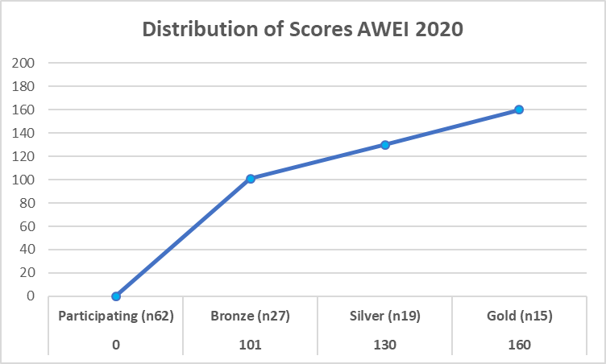
2020 Standard Employer Score Distribution: Recognition Tiers
Notes:
These next couple of slides contain general benchmarking data applicable to all submitting organisations and provide some context to the history and ongoing shift in practice.
The chart shows this year’s score distribution across all submissions. Those organisations just starting their LGBTQ inclusion initiatives are encouraged to participate even though their score may be extremely low. This provides an initial benchmark by which they can assess progress over the next year.
Entry point to the bronze, silver and gold tiers are indicated by the vertical lines on the chart. The number of employers within each tier is indicated within brackets.
The table shows the historical entry point score to each of the tiers over the six years of the index and how the entry point to each of the tiers has shifted. Bronze entry point has steadied over the last three years, whereas Silver and Gold Tier entry points continue to climb.

Slide 55
Tier: Participating Employers
TOP 3: (alphabetical)
Australian Signals Directorate
Crown Resorts
Dept. of Foreign Affairs and Trade
Newmont
*Two organisations achieved the same score.*

Slide 56
Tier: Bronze Employers
TOP 3: (alphabetical)
Dept. of Education and Training
Griffith University
Services Australia
Settlement Services International
*Two organisations achieved the same score.*

Slide 57
Tier: Silver Employers
TOP 3: (alphabetical)
Deakin University
KPMG Australia
Qantas
CBRE
*Two organisations achieved the same score.*

Slide 58
Tier: Gold & Platinum Employers
TOP 3: (alphabetical)
Capgemini
RMIT University
QBE Insurance

